Slide 1
ORGANISATIONAL
BEHAVIOUR
CHAPTER-12
GROUP DYNAMICS

Slide 2
LEARNING OBJECTIVES
Small groups-formal, or informal - are inevitable in organisations. A group refers to a collection of individuals who have mutually dependent relationships.
Groups are of various types. There are formal and informal groups, open and closed, in-groups and out-groups.
People join groups of some type seeking affiliation, security, esteem and for other similar reasons.
A group does not come into existence overnight. It passes through different stages before abandoning itself.
Groups serve several useful purposes to an organisation, main benefit being task accomplishment.
Groups need structuring for effective functioning. Group leadership, group norms, group size, group roles, group tasks and group cohesiveness are the issues relevant in group structuring.

Slide 3
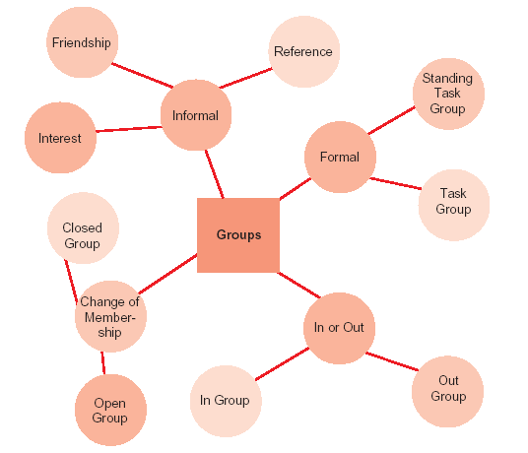
Types of Groups

Slide 4
Contributions of Formal Groups
Contributions to Organisations
1. Accomplish complex, independent tasks that are beyond the capabilities of individuals.
2. Create new ideas
3. Coordinate interdepartmental efforts.
4. Solve complex problems requiring varied information and perspectives.
5. Implement action plans.
6. Socialise and train newcomers.
Contributions to Individuals
1. Satisfy needs for affiliation.
2. Confirm identity and enhance self-esteem.
3. Test and share perceptions of social reality.
4. Reduce feelings of insecurity and powerlessness.
5. Provide a mechanism for solving personal and interpersonal problems.

Slide 5
Contributions of Informal Groups
Contributions to Individuals
1. Satisfaction of social and affiliation needs.
2. Satisfaction of needs for security and support.
3. Enhanced status for members if the group is perceived by others as prestigious.
4. Enhanced feelings of self-esteem if a member is valued by other group members.
5. Feeling more competent by sharing the power of the group to influence and achieve.
Contributions to Organisations
1. Solidify common social values and expectations congruent with organisational culture.
2. Provide and enforce guidelines for appropriate behaviour.
3. Provide social satisfaction unlikely for anonymous individual workers to experience.
4. Provide a sense of identity that often includes a certain degree of status.
5. Enhance members’ access to information.
6. Help integrate new employees into the formal expectations of the organization.

Slide 6
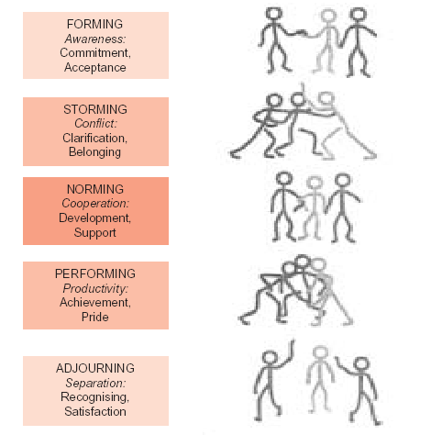
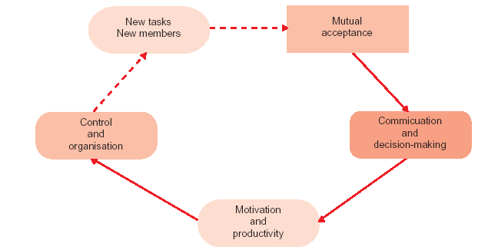
Stages of Group Development

Slide 7
Some Roles Commonly Played by Group Members
Task-Oriented Roles Relations-Oriented Roles Self-Oriented Roles
Initiator-Contributors Harmonisers Blockers
Recommend new-solutions to Mediate group conflicts Act stubborn and resistant to the group members group
Information Seekers Compromisers Recognition Seekers
Attempt to obtain the necessary Shift opinions to create Call attention to their own facts group harmony achievements
Opinion givers Encouragers Dominators
Share own opinion with others Praise and encourage others Assert authority by manipulating the group
Energisers Expediters Avoiders
Stimulate the group into action Suggest ways the groups Maintain distance, isolate whenever interest drops can operate more smoothly themselves from fellow group members

Slide 8
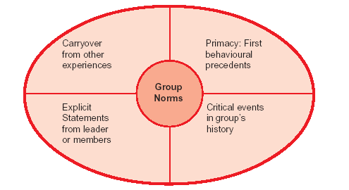
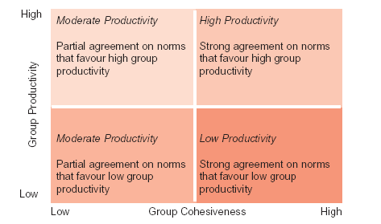
Four Sources of Group
Norms
How Cohesiveness and Productivity
Norms Affect Group Productivity

Slide 9
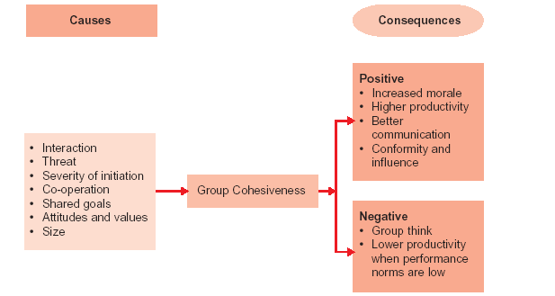
Group Cohesiveness – Causes and Consequences

Slide 10
Key Terms
Groups
Norms
Roles
Status congruence
Groupthink
Risky shifts
Social loafing
Group dynamics
Group development
Tasks
Cohesiveness
Polarisation
Cautious shifts

